Slide 1




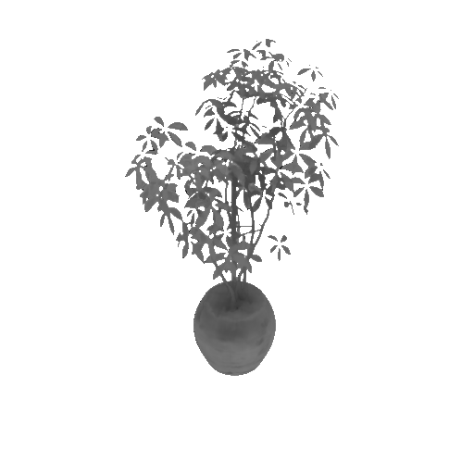
Neural Radiance Field
A novel, data-driven solution to the long-standing problem in computer graphics of the realistic rendering of virtual worlds.
Haizhao Dai 2022/09/19

Slide 2
Overview
Novel View Synthesis & Reconstructions
The Input & Output of NeRF
Scene Representations
Neural Scene Representations
Light Field / Radiance Field
Differentiable Rendering
Volume Rendering
Positional Encoding
Sampling Strategies

Slide 3
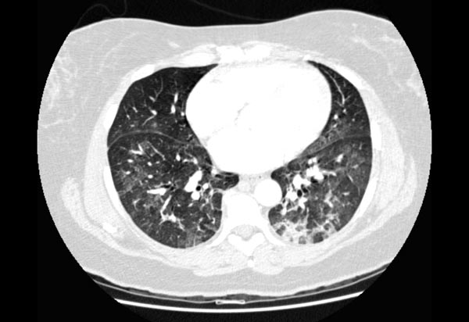
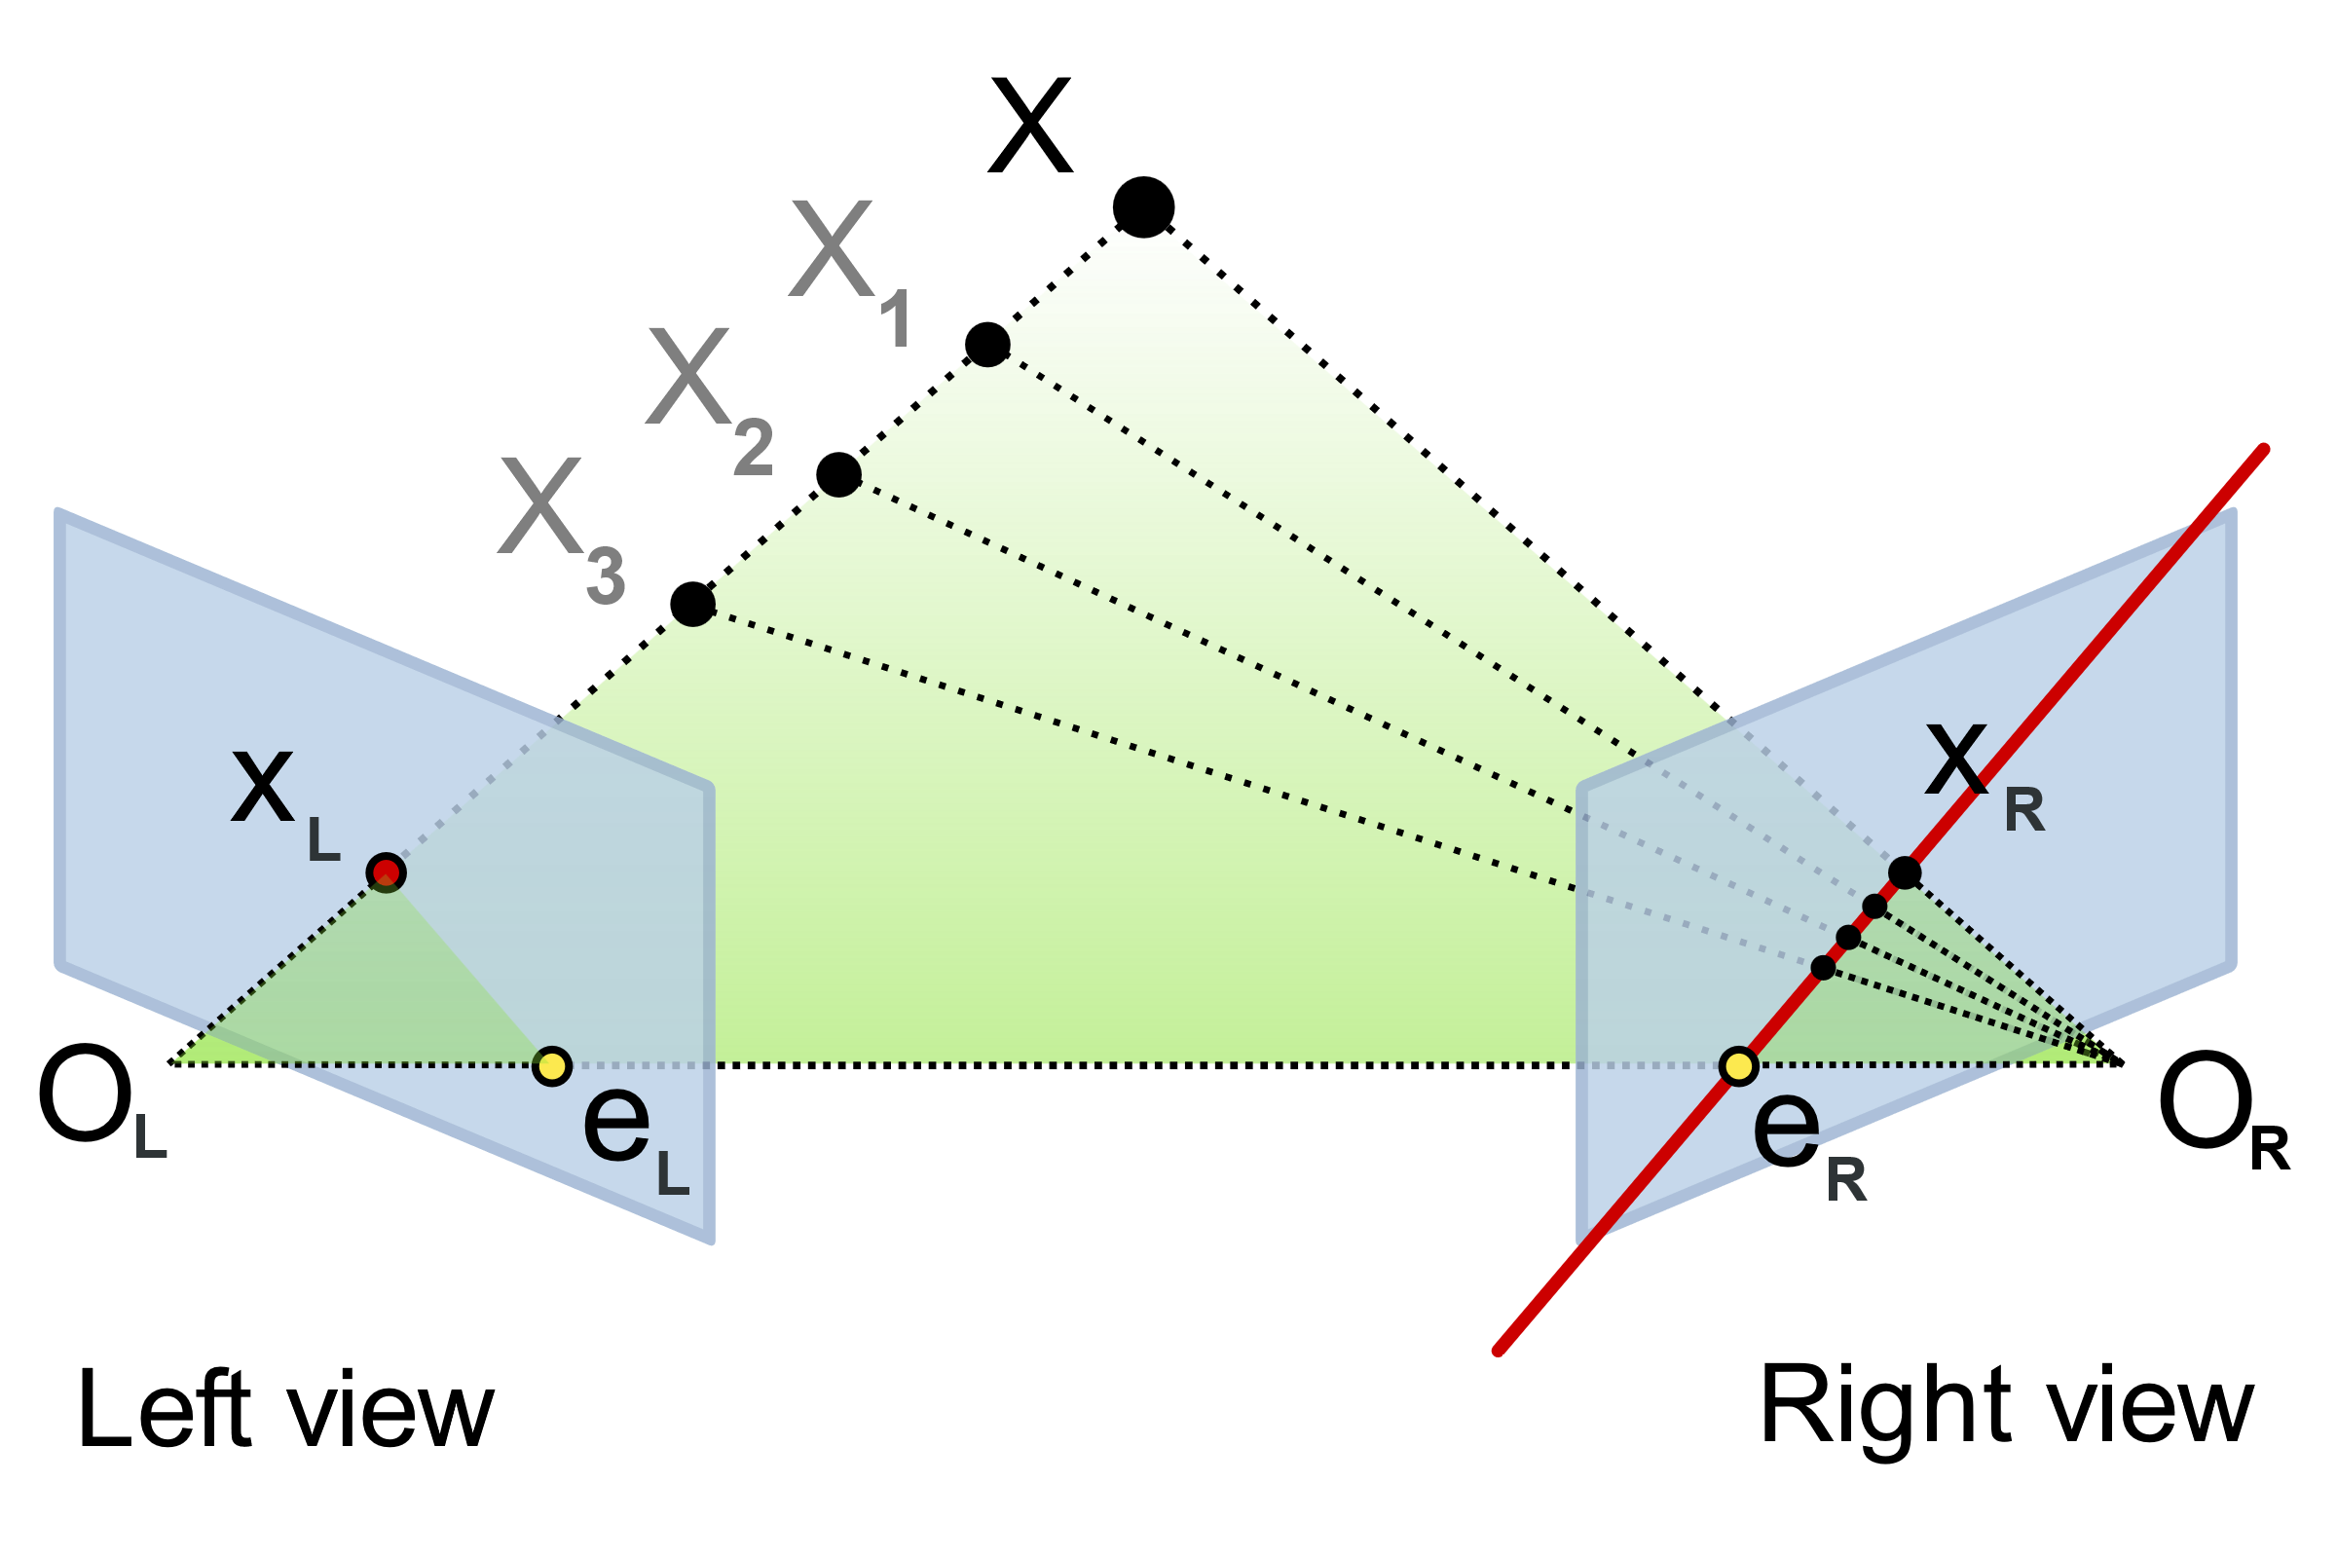
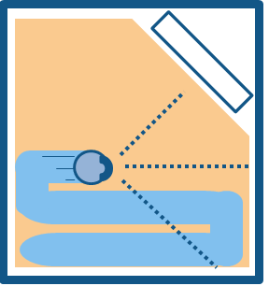
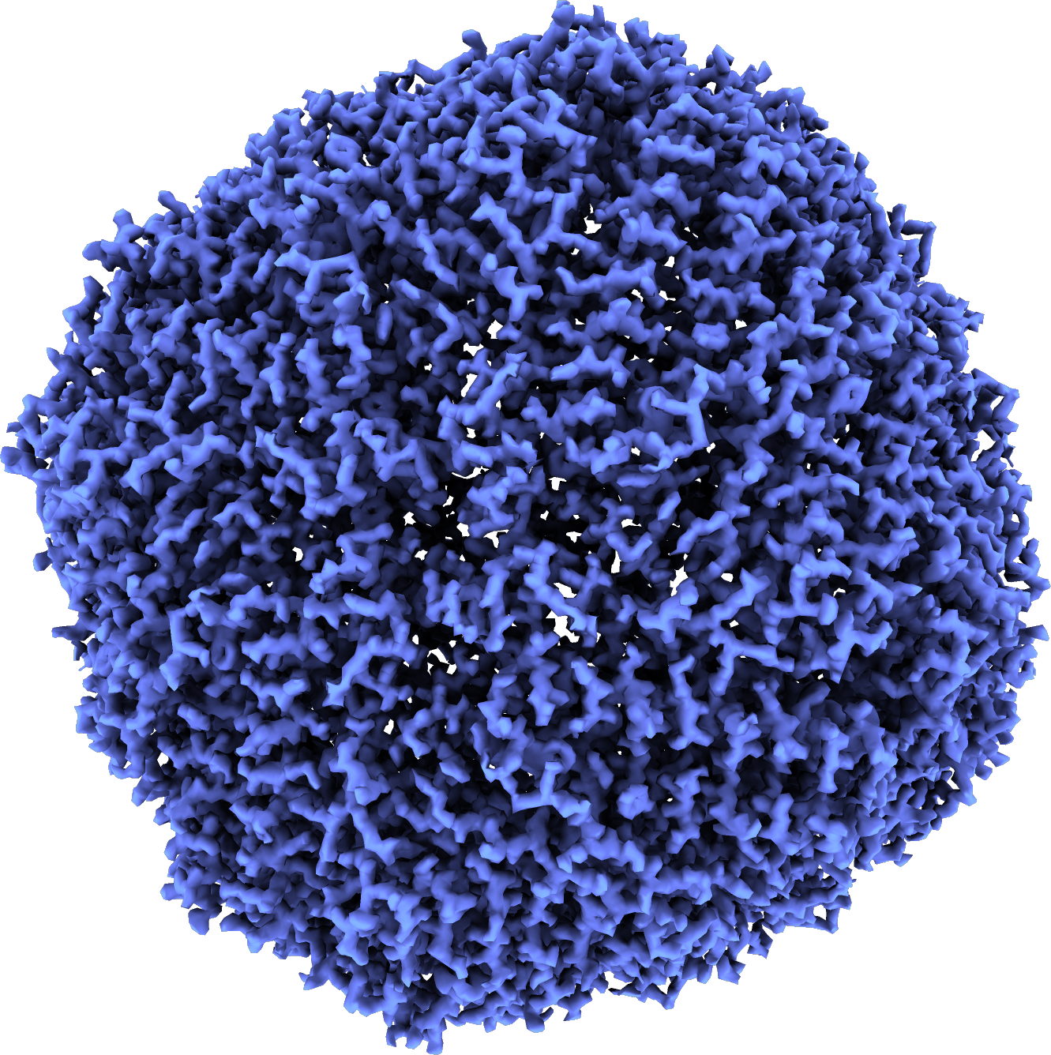
Novel View Synthesis & Reconstructions
Photo-realistic rendering.
Rasterization / Ray tracing,
Synthesizing views under camera viewpoint transformations from one or multiple input images.
Tomography
Epipolar Geometry
SLAM

Slide 4
The Input & Output of NeRF
Continuous 5-D coordinate.
Input of the network:
Output of the network:
Input of the whole pipeline:
Output of the whole pipeline:
Volume density and view-dependent emitted radiance.
A set of calibrated 2-D images.
A reconstructed 3-D scene.

Slide 5
Scene Representations
Specifically defined representations of geometry and material properties.
A scene consists of one or more objects.
Surface and volumetric representations.
Discretized and continuous representations.
Explicit and implicit representations.

Slide 6
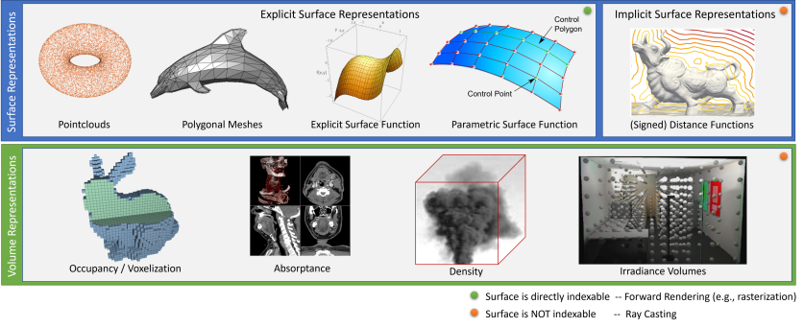
Surface and Volumetric Representations
Surface representations store property w.r.t. the surface such as colors, normal vectors or brdf.
Volumetric representations volumetric properties such as densities, opacities or occupancies.

Slide 7
Discretized and Continuous Representations
For both surface and volumetric representations, there are continuous and discretized counterparts.
 | Discretized | Continuous
Surface | Pointclouds, meshes | Parametric Surfaces, SDFs
Volumetric | Voxels, 3D textures | Neural Networks

Slide 8
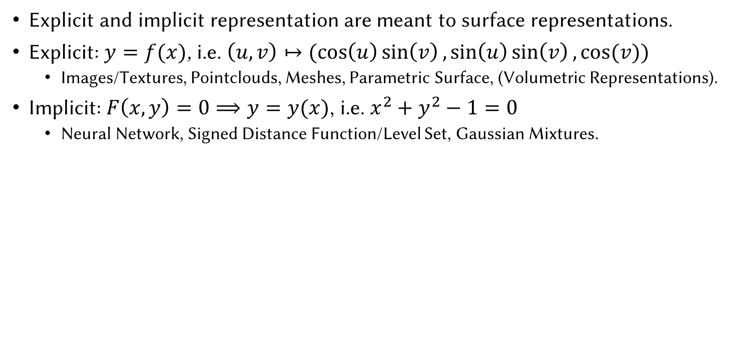
Explicit and Implicit Representations
Explicit and implicit representation are meant to surface representations.
Explicit: $y=f(x)$, i.e. $\left(u,v\right)↦(cos\left(u\right)\sin\left(v\right),sin\left(u\right)\sin\left(v\right), cos⁡(v))$
Images/Textures, Pointclouds, Meshes, Parametric Surface, (Volumetric Representations).
Implicit: $F\left(x,y\right)=0⟹y=y(x)$, i.e. $x^{2}+y^{2}−1=0$
Neural Network, Signed Distance Function/Level Set, Gaussian Mixtures.

Slide 9
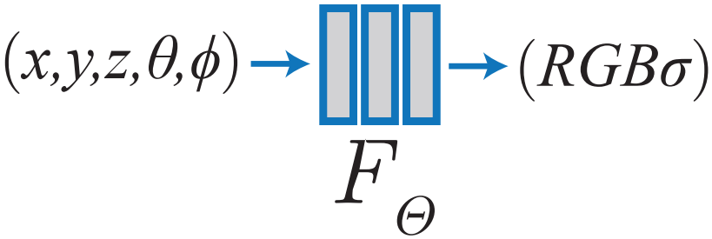
Explicit Continuous Volumetric Representations
NeRF can be categorized as explicit continuous volumetric representations.
Why not other representations?
Explicit v.s. Implicit.
Continuous v.s. Discretized.
Surface v.s. Volume.
Why some one says NeRF is implicit representation?
Embedding.

Slide 10
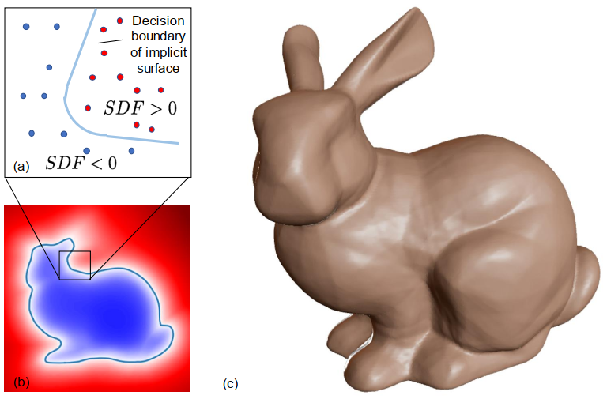
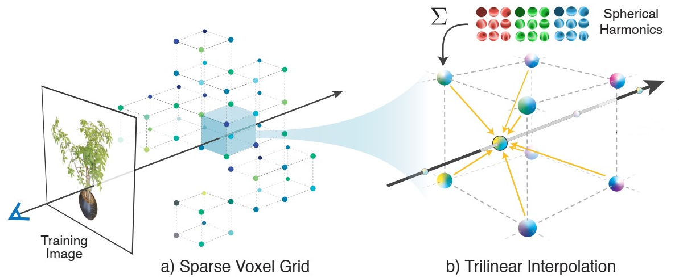
Neural Scene Representations
NeRF can be categorized as neural scene representation.
DeepSDF (Park et al. CVPR 2019)
Plenoxels (Yu et al. CVPR 2022)
DeepSDF
Plenoxels

Slide 11
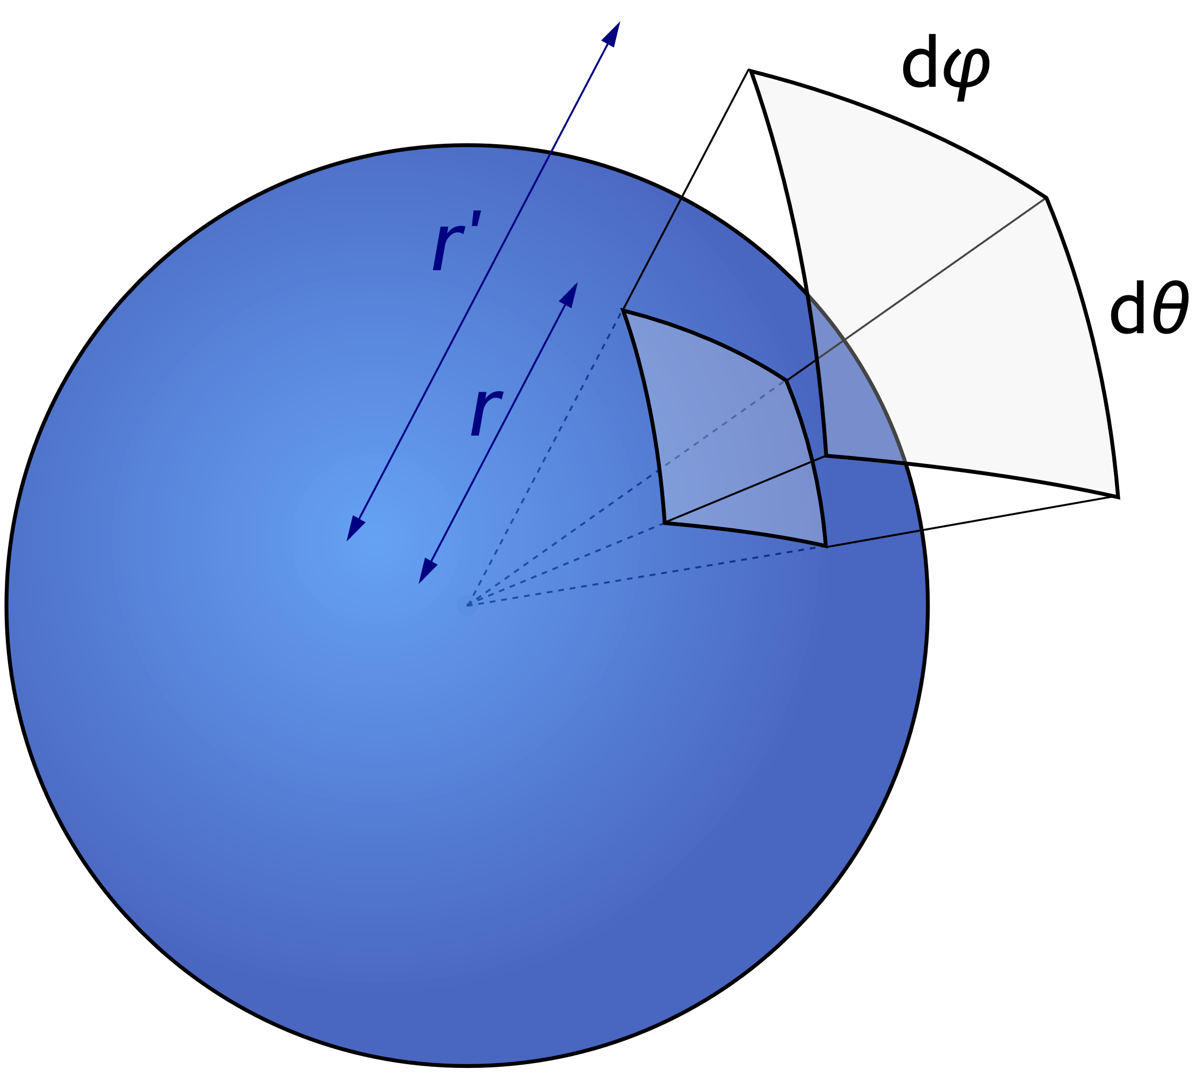
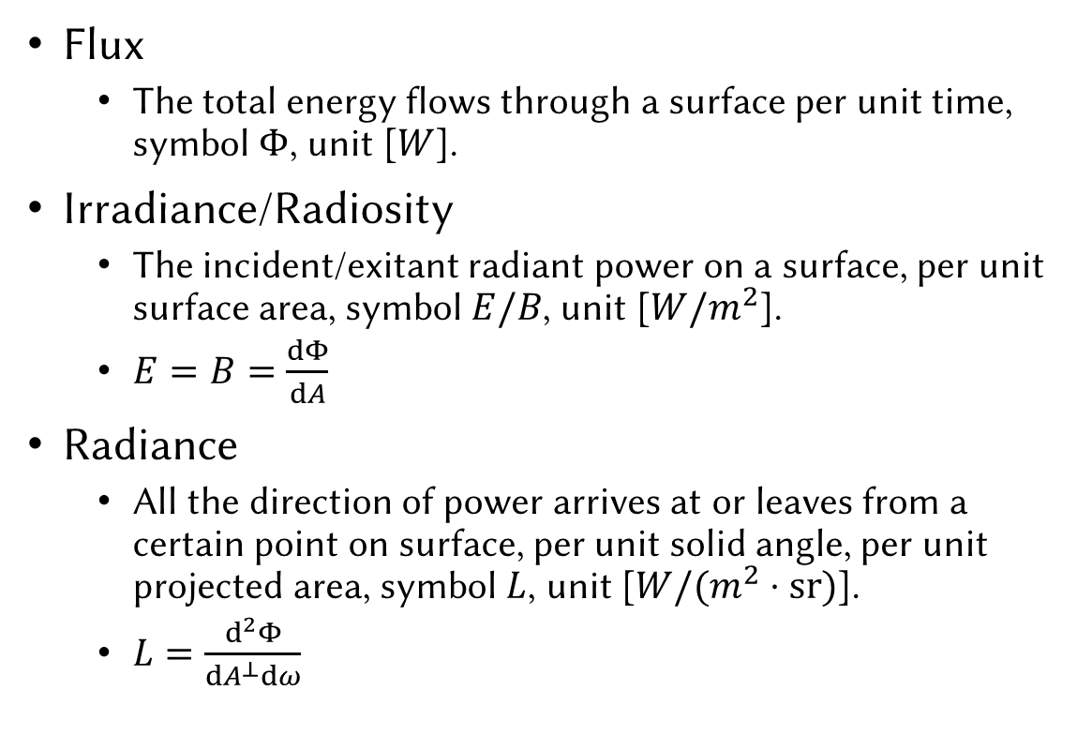
Radiometry
Flux
The total energy flows through a surface per unit time, symbol $Φ$, unit [$W$].
Irradiance/Radiosity
The incident/exitant radiant power on a surface, per unit surface area, symbol $E/B$, unit [$W/m^{2}$].
$E=B=\frac{dΦ}{dA}$
Radiance
All the direction of power arrives at or leaves from a certain point on surface, per unit solid angle, per unit projected area, symbol $L$, unit [$W/(m^{2}⋅sr)$].
$L=\frac{d^{2}Φ}{dA^{⊥}dω}$

Slide 12
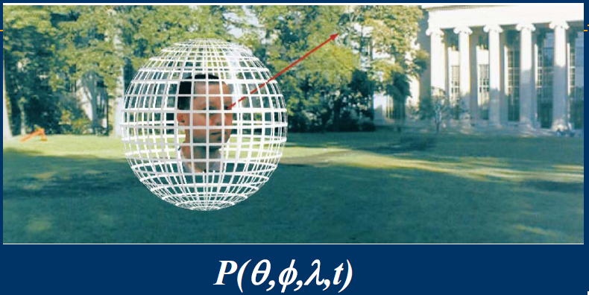
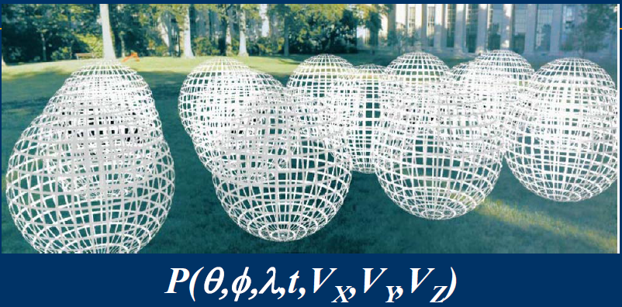
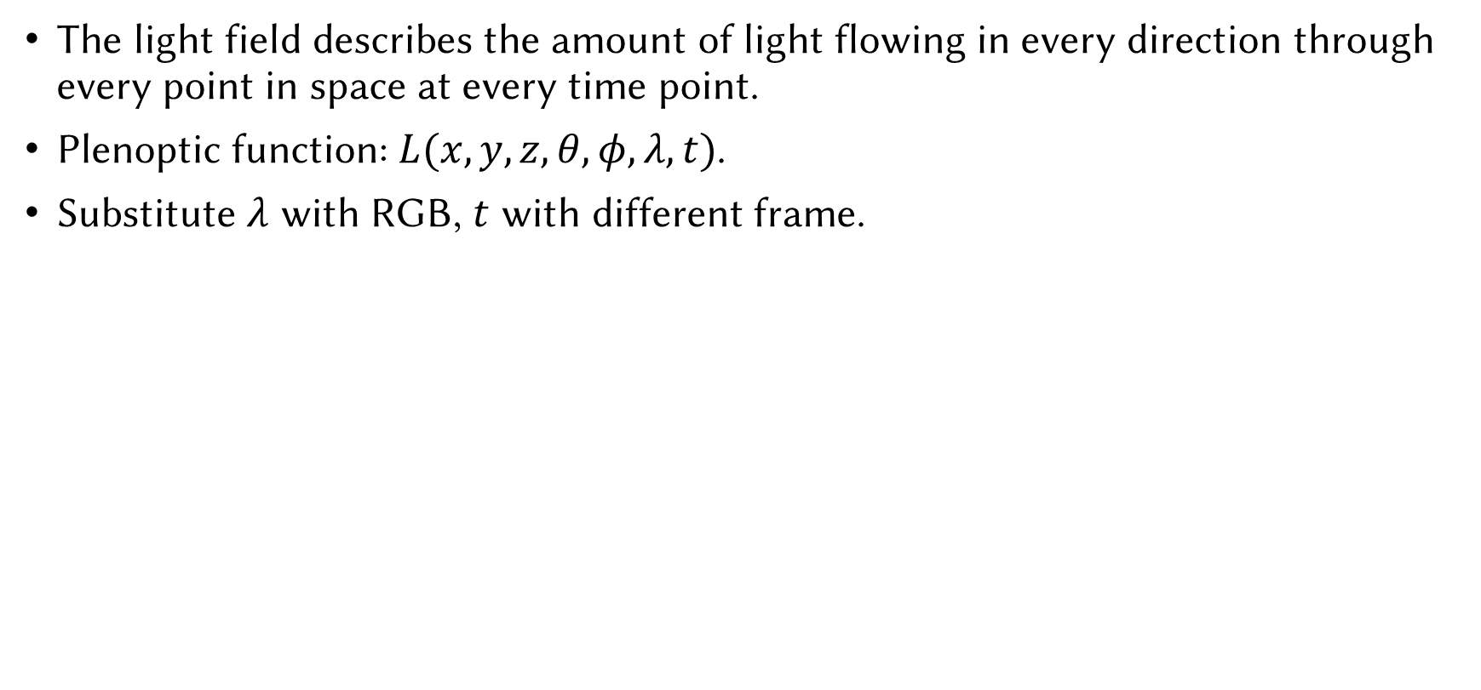
Light Field / Radiance Field
The light field describes the amount of light flowing in every direction through every point in space at every time point.
Plenoptic function: $L(x,y,z,θ,φ,λ,t)$.
Substitute $λ$ with RGB, $t$ with different frame.

Slide 13
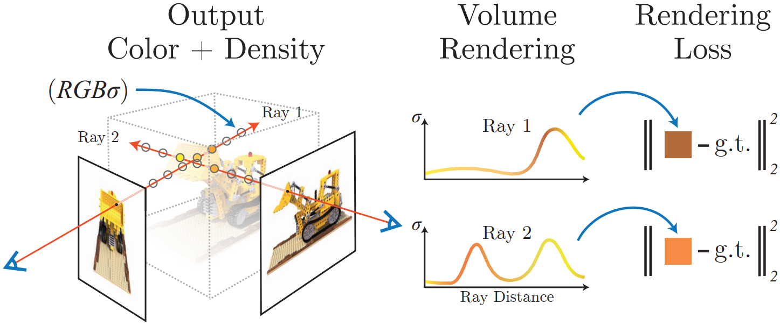
Differentiable Rendering
What is differentiable rendering?
Inverse rendering

Slide 14
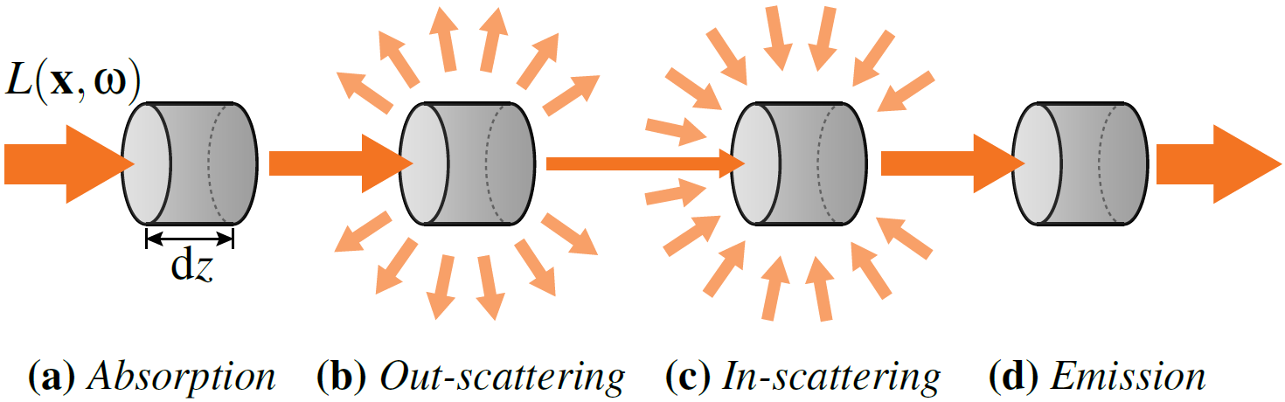
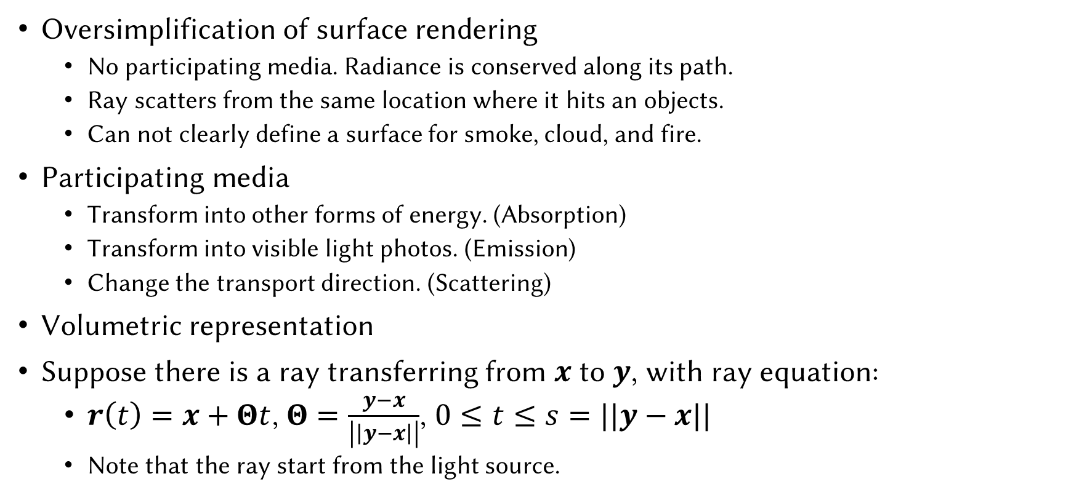
Participating Media
Oversimplification of surface rendering
No participating media. Radiance is conserved along its path.
Ray scatters from the same location where it hits an objects.
Can not clearly define a surface for smoke, cloud, and fire.
Participating media
Transform into other forms of energy. (Absorption)
Transform into visible light photos. (Emission)
Change the transport direction. (Scattering)
Volumetric representation
Suppose there is a ray transferring from $x$ to $y$, with ray equation:
$r\left(t\right)=x+Θt$, $Θ=\frac{y−x}{\left|\left|y−x\right|\right|}$, $0≤t≤s=||y−x||$
Note that the ray start from the light source.

Slide 15
Absorption
Absorption coefficient $σ_{a}(z)$ (unit [$m^{−1}$]).
The probability of a photon get absorbed in a volume.
In general, absorption is isotropic (w.r.t. input direction).

Slide 16
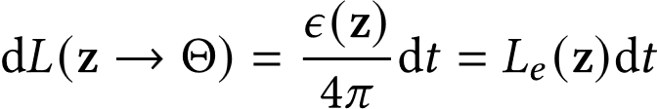
Emission
Volume emittance: $ε(z)$ (units [$W/m^{3}$])
In general, emission is isotropic (w.r.t. output direction): $ε(z)/4π$ (units [$W/(m^{3}⋅sr)$])
The radiance added to the ray due to the volume emittance:

Slide 17
Out-scattering
Scattering coefficient $σ_{s}(z)$ (unit [$m^{−1}$]).
Out-scattering is identical to absorption.
Extinction coefficient $σ_{t}\left(z\right)=σ_{a}\left(z\right)+σ_{s}\left(z\right)$ (unit [$m^{−1}$]).

Slide 18
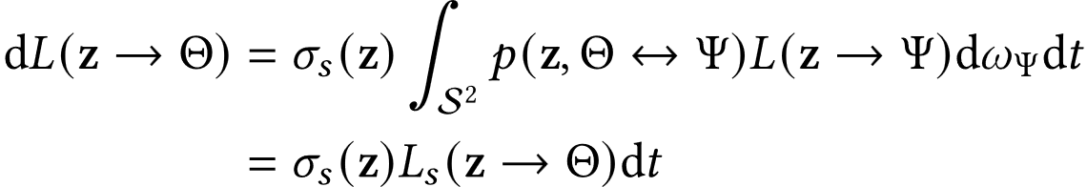
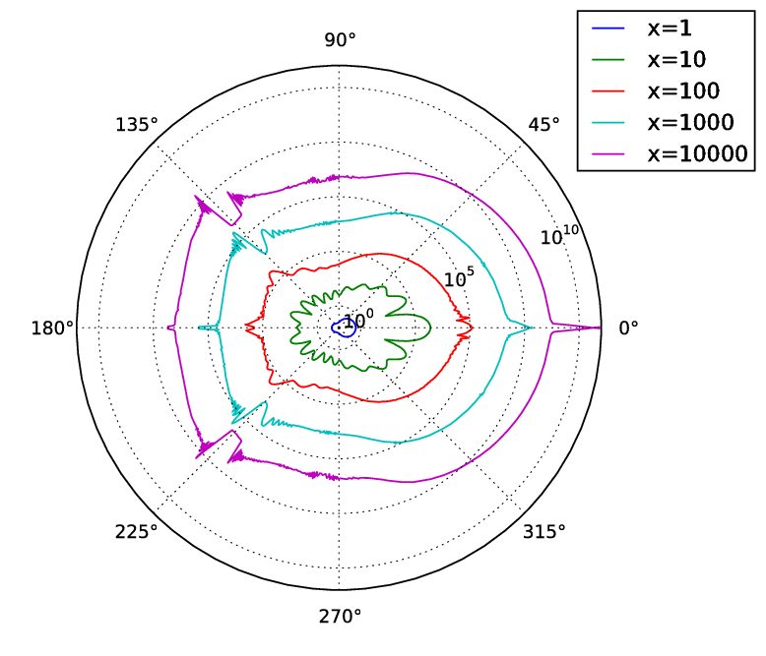
In-scattering
Scattering is not isotropic (w.r.t. output direction).
Phase function.

Slide 19
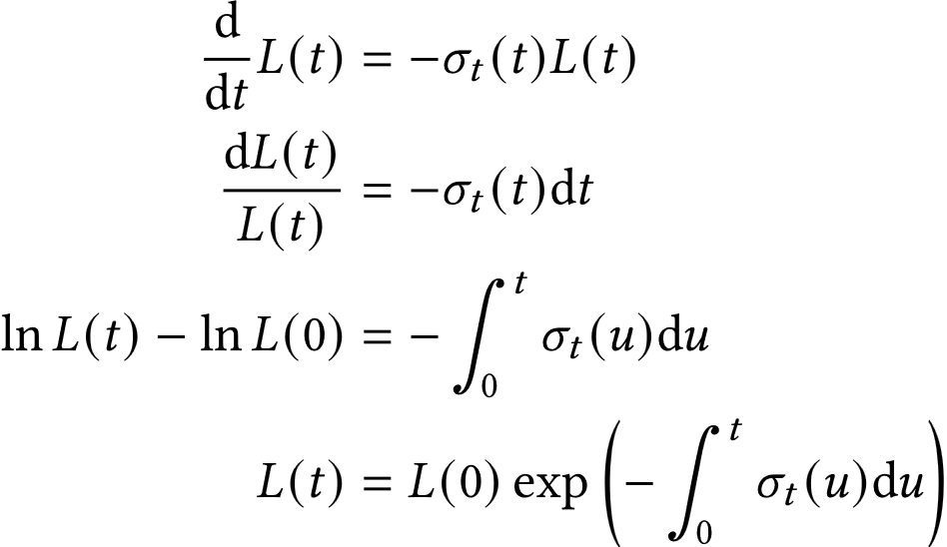
Radiative Transfer Equation
A kind of Boltzmann equation.
Solution to first-order homogeneous linear ODE:

Slide 20
Transmittance
Optical thickness: $τ\left(x,z\right)$/$τ\left(0, t\right)$.
$τ\left(0,t\right)=−\int_{0}^{t}{σ_{t}(u)du}$
Transmittance: $T\left(x,z\right)$/$T\left(0, t\right)$.
Surface definition: The radiant flux transmitted by that surface / The radiant flux received by that surface.
$L\left(t\right)/L\left(0\right)=T(0,t)$
The percentage of radiance reserved (Statistically)
The probability of a photo pass through (Probability)

Slide 21
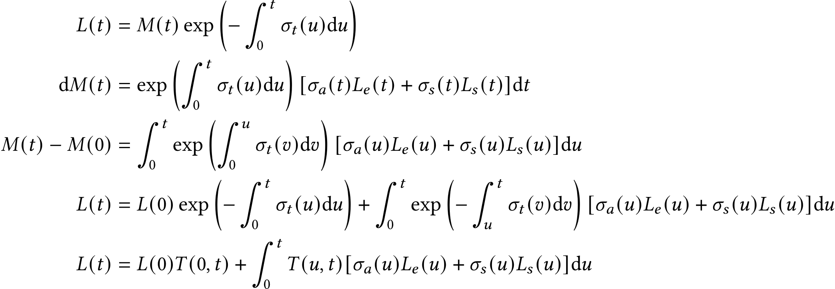
Radiative Transfer Equation
Solution to first-order inhomogeneous linear ODE:

Slide 22
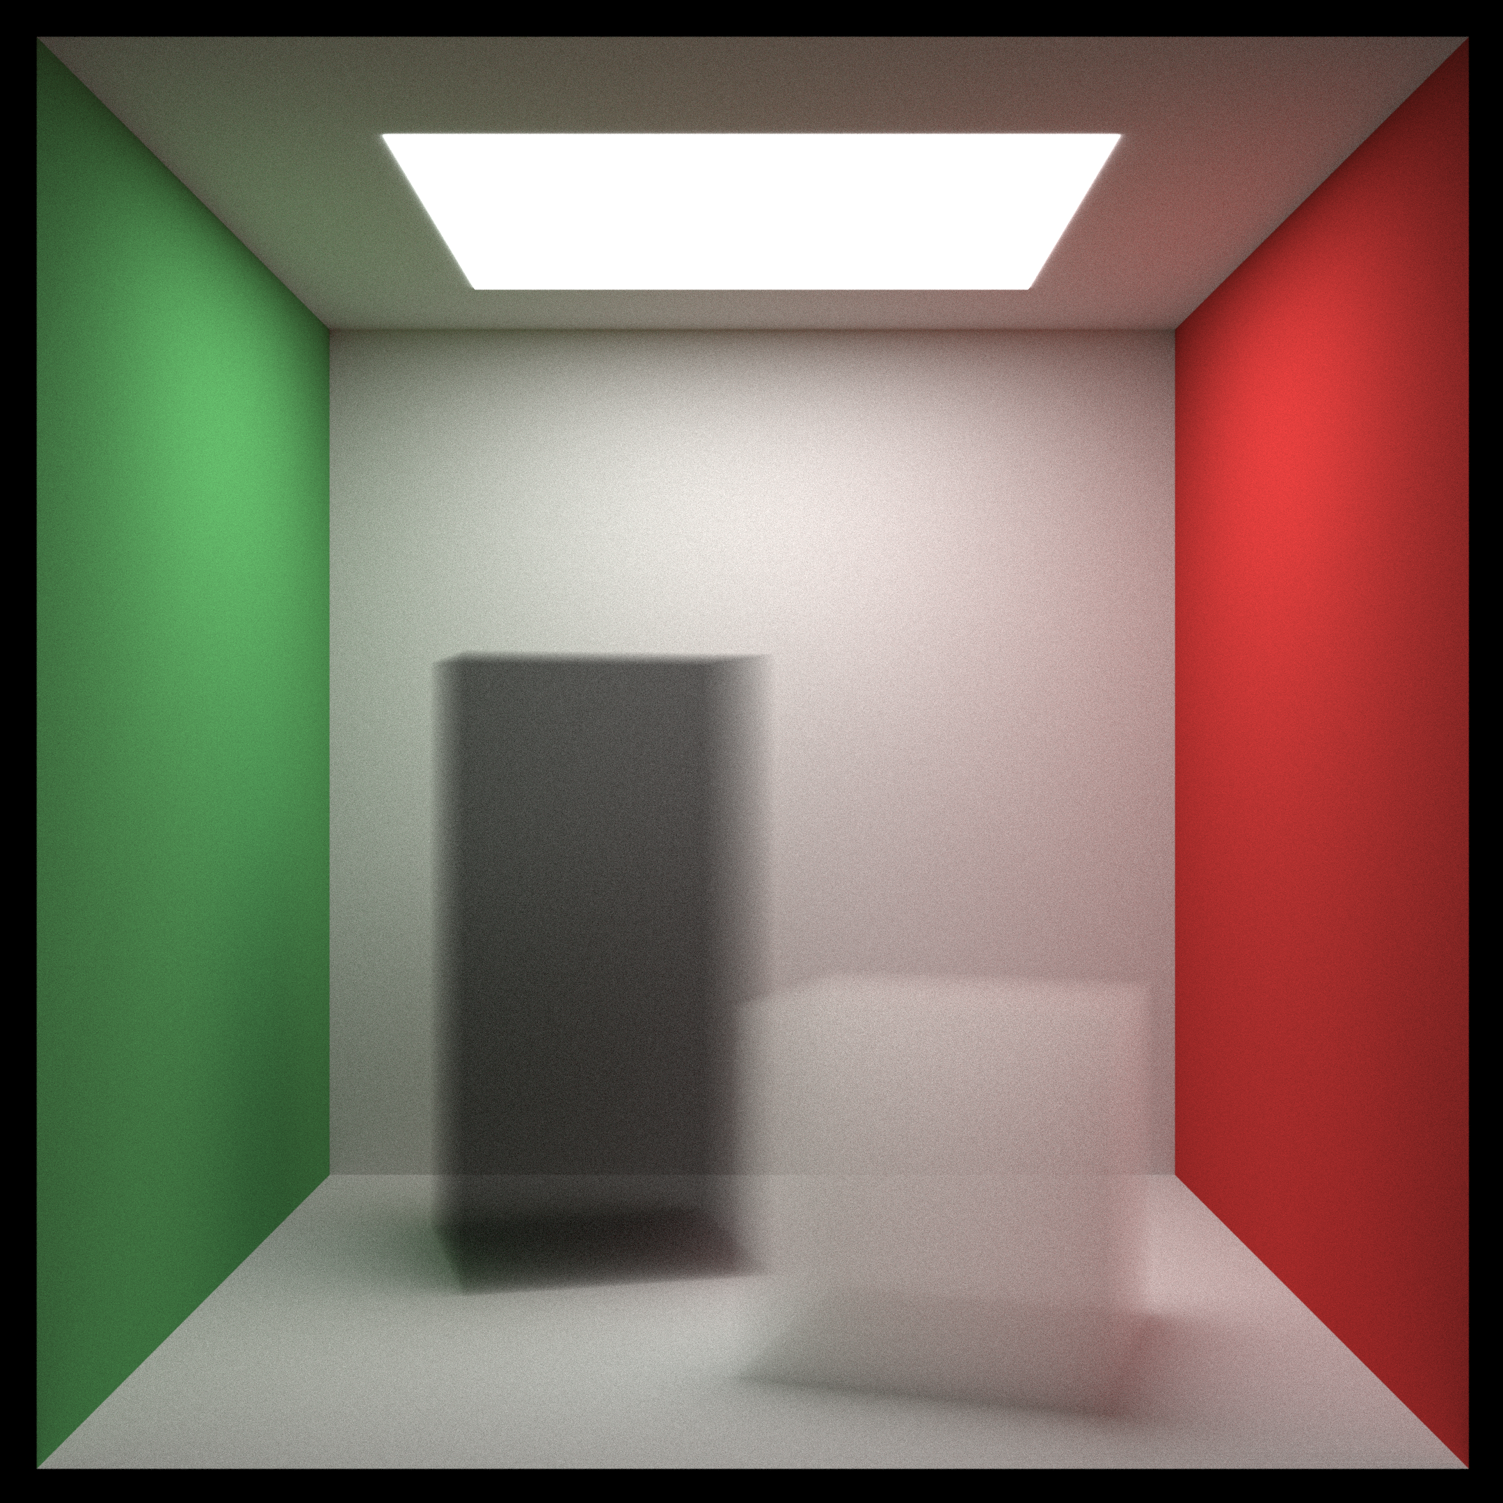
Results
Path tracing (50 times) + volume rendering

Slide 23
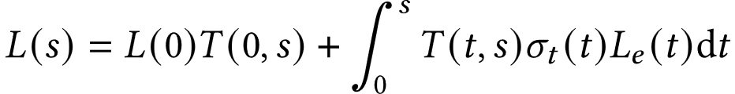
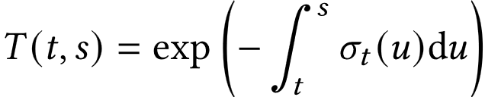
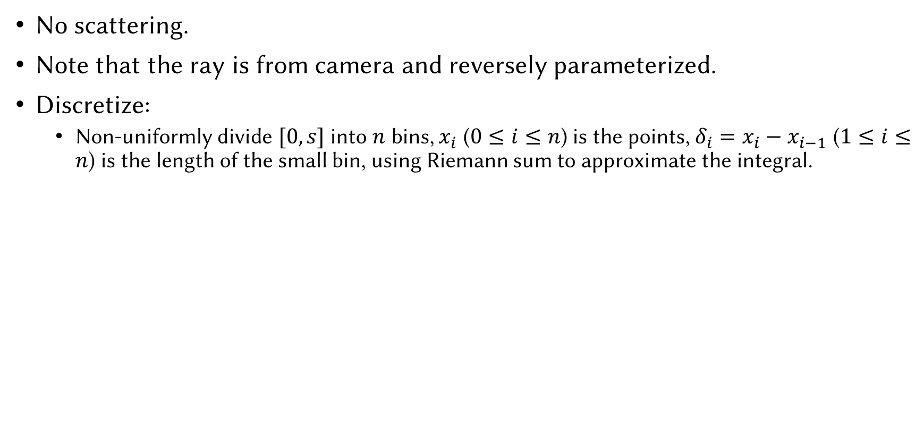
NeRF’s Setting
No scattering.
Note that the ray is from camera and reversely parameterized.
Discretize:
Non-uniformly divide $[0,s]$ into $n$ bins, $x_{i}$ ($0≤i≤n$) is the points, $δ_{i}=x_{i}−x_{i−1}$ ($1≤i≤n$) is the length of the small bin, using Riemann sum to approximate the integral.

Slide 24
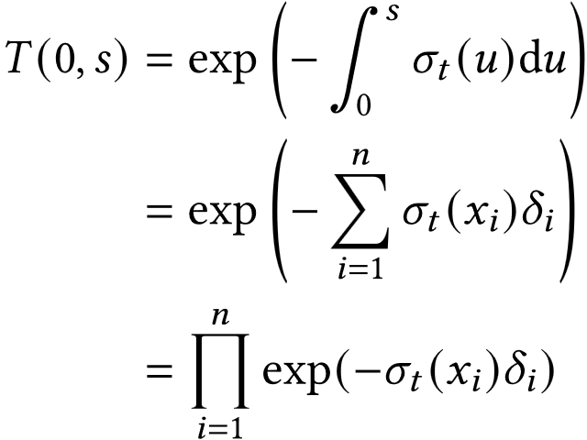
Discretizing
Non-uniformly divide $[0,s]$ into $n$ parts, $x_{i}$ is the points, $δ_{i}$ is the length of the small bin, using Riemann sum to approximate the integral.
Transmittance:

Slide 25
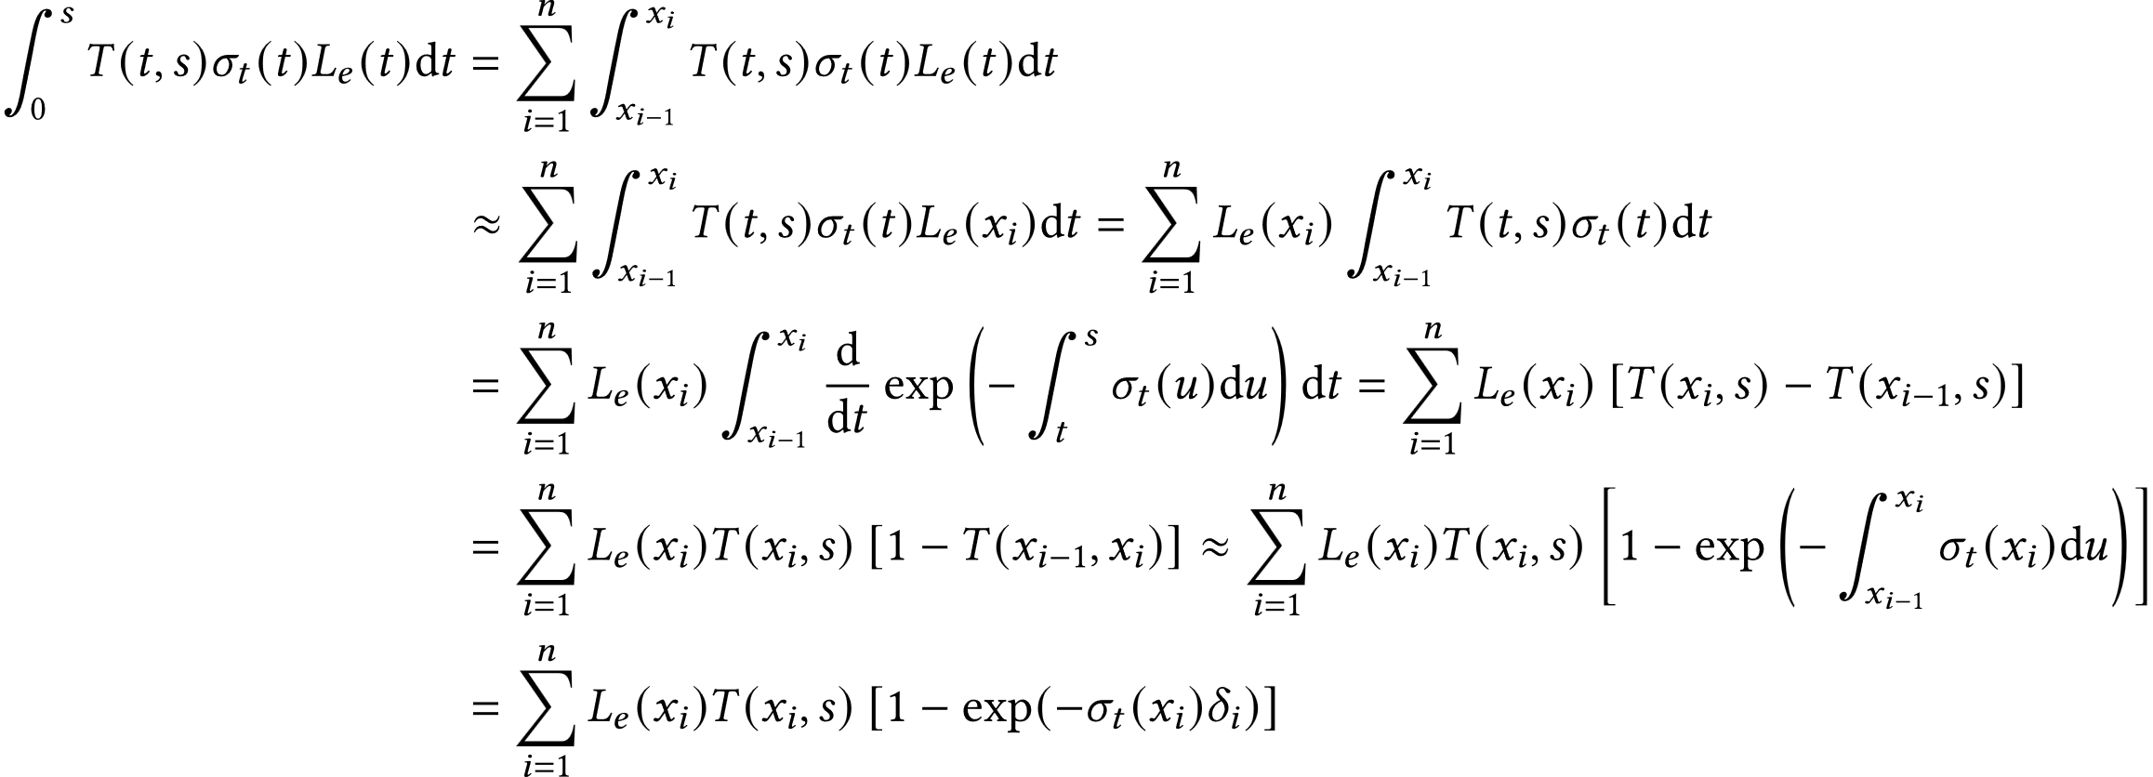
Discretizing
Non-uniformly divide $[0,s]$ into $n$ parts, $x_{i}$ is the points, $δ_{i}$ is the length of the small bin, using Riemann sum to approximate the integral.
Radiance:
Thus we define $α_{i}=1−\exp{(σ_{t}\left(x_{i}\right)δ_{i})}$

Slide 26
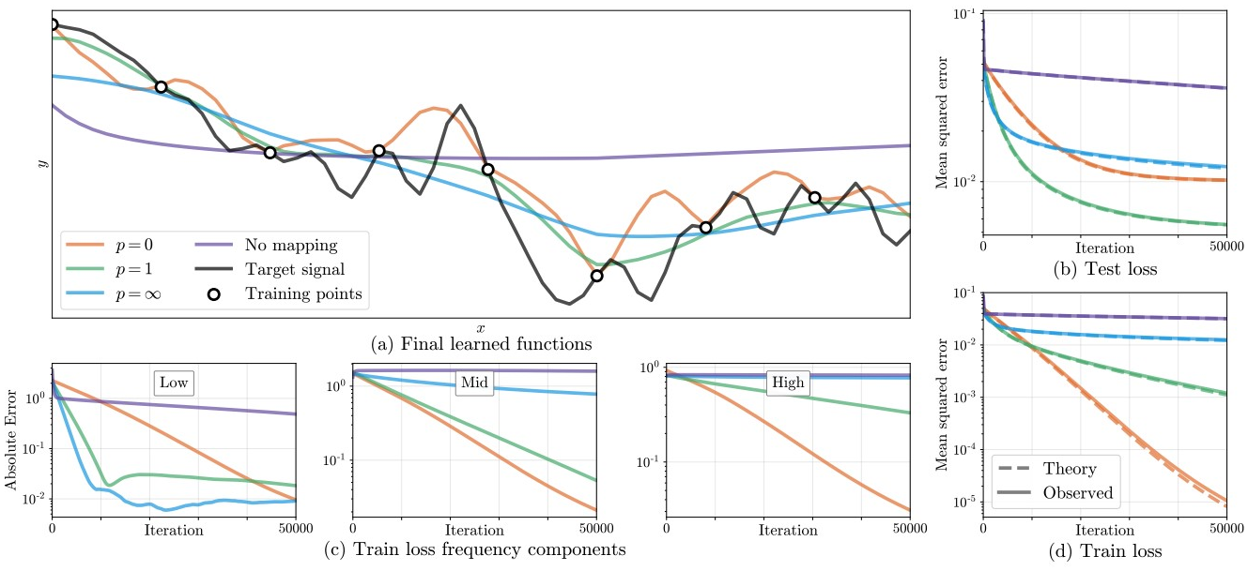
Positional Encoding
Attention Is All You Need. (Vaswani et al. NeurIPS 2017)
A mapping that maps input coordinates from low dimensional space to high dimensional encoding space.
Fourier Features Let Networks Learn High Frequency Functions in Low Dimensional Domains. (Tancik et al. NeurIPS 2020)

Slide 27
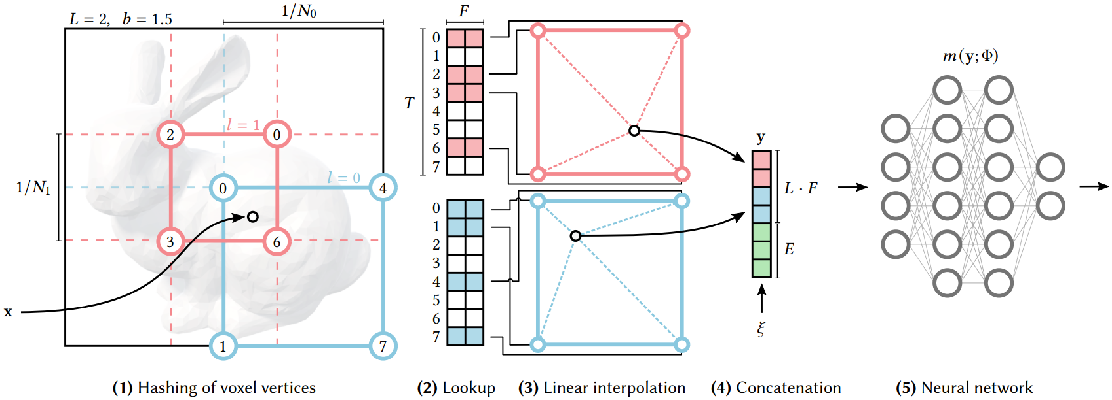
Hash Encoding
Instant Neural Graphics Primitives with a Multiresolution Hash Encoding. Muller et al. Siggraph 2022 Best Paper Award

Slide 28
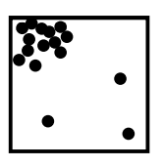
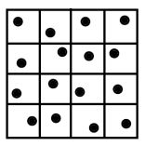
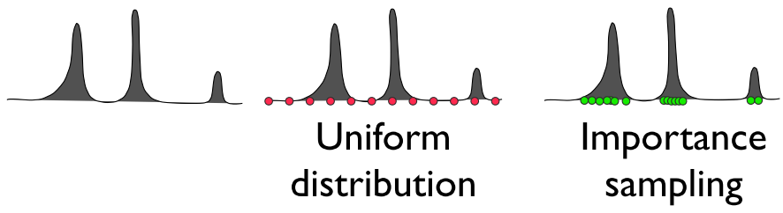
Sampling Strategies
Monte Carlo Integral.
Stratified sampling.
Importance sampling.

Slide 29
Discussions
Why NeRF works?
Positional Encoding (Neural Tangent Kernel Analysis)
5D Neural Radiance Fields based on MLP (Neural Representations)
Volume Rendering (Differentiable Rendering)
Sampling (Performance Improvement)
What are the limitations of NeRF?
Extremely slow for rendering and training
Bad Surface reconstruction
Cannot model reflection and refraction well
Hard to edit the local area
…

Slide 30
References
Tewari et al. Advances in Neural Rendering. EuroGraphics 2022.
Muller et al. Instant Neural Graphics Primitives with a Multiresolution Hash Encoding. Siggraph 2022 Best Paper.
Dutré et al. Advanced Global Illumination. 2006.
Kutz et al. Spectral and Decomposition Tracking for Rendering Heterogeneous Volumes. Siggraph 2017.
Novák et al. Monte Carlo Methods for Volumetric Light Transport Simulation. Eurographics 2018.
Peter Shirley. Ray Tracing in One Weekend Series. https://raytracing.github.io

